Slide 1
Test Containers- essentials
45426: Teste e Qualidade de Software
Ilídio Oliveira
v2025-11-19

Slide 2
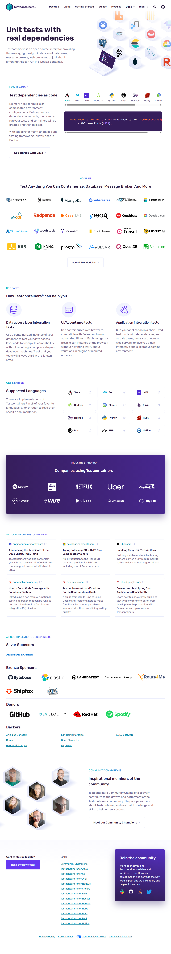
“Unit tests” in a broad sense (supporting tests in isolation practices). Not strict unit tests…

Slide 3
Why?
Provision complex dependencies (as containers) for the scope of the tests, then dispose

Slide 4
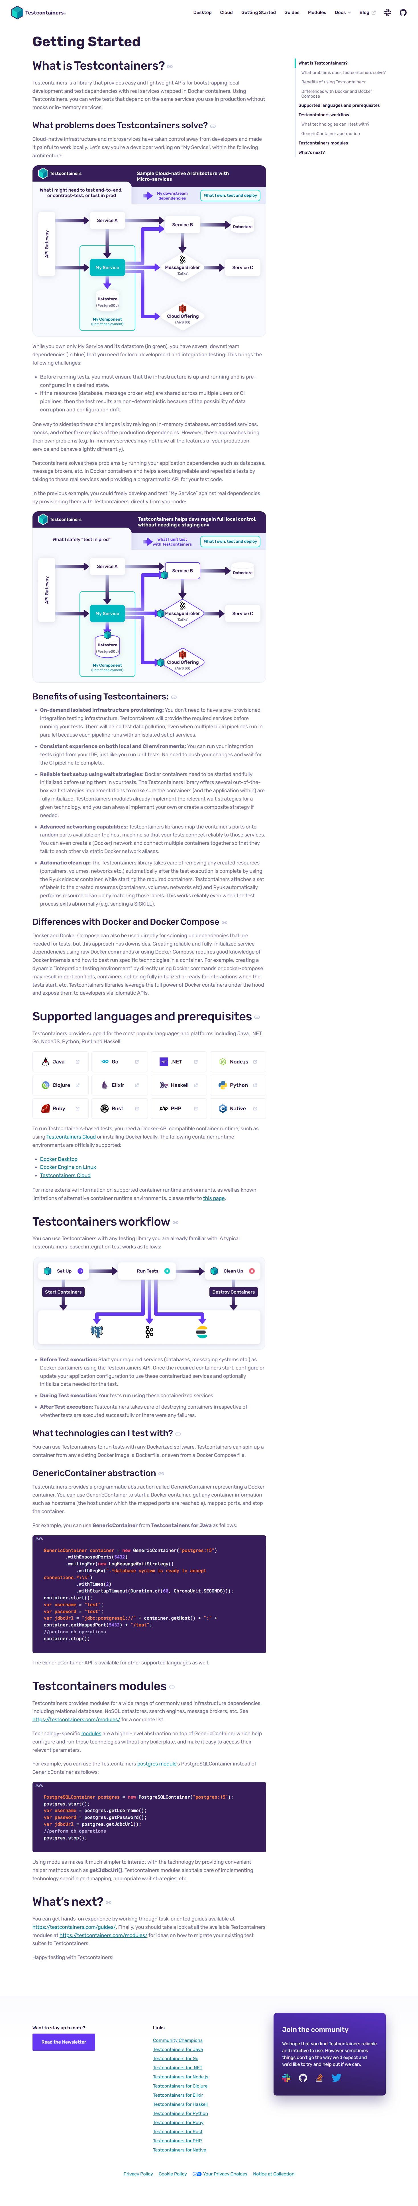

Test Containers vs mocking
How to test “My Service”?
  Embedded database replacing PostgreSQL
  Mocks for interfaces with Service B, Message Broker, Cloud
Drawbacks
  testing in a simplified but “fake” environment, which can hide problems

Slide 5
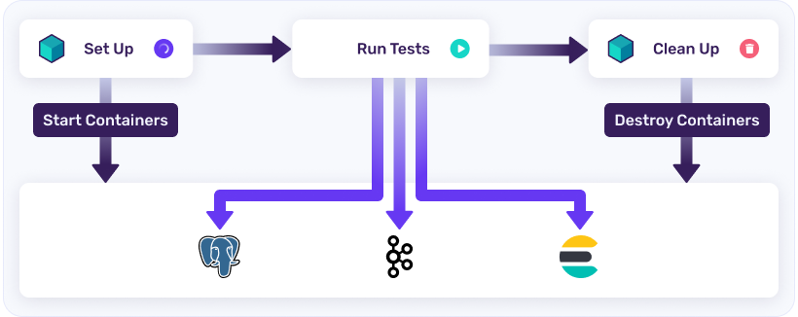




Test Containers for integration testing
Instantiate containers for dependencies
  The lifecycle of containers is automatially managed.
  Run againts “true” services.

Slide 6
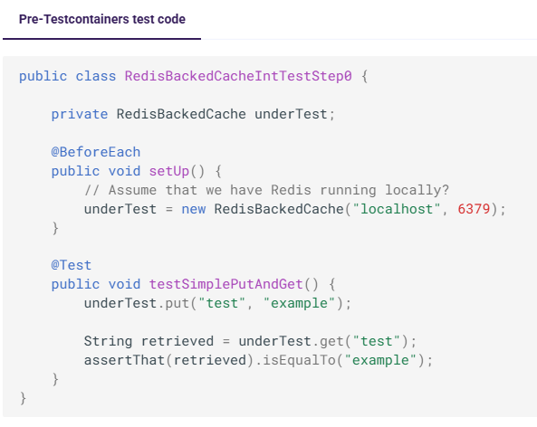
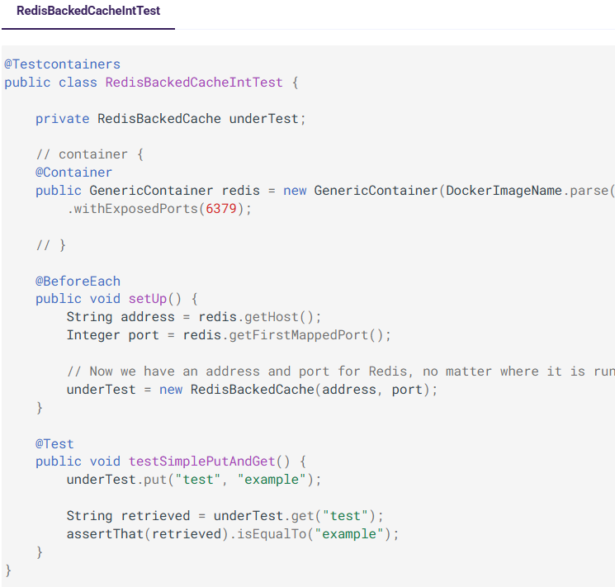

Example 1

Slide 7
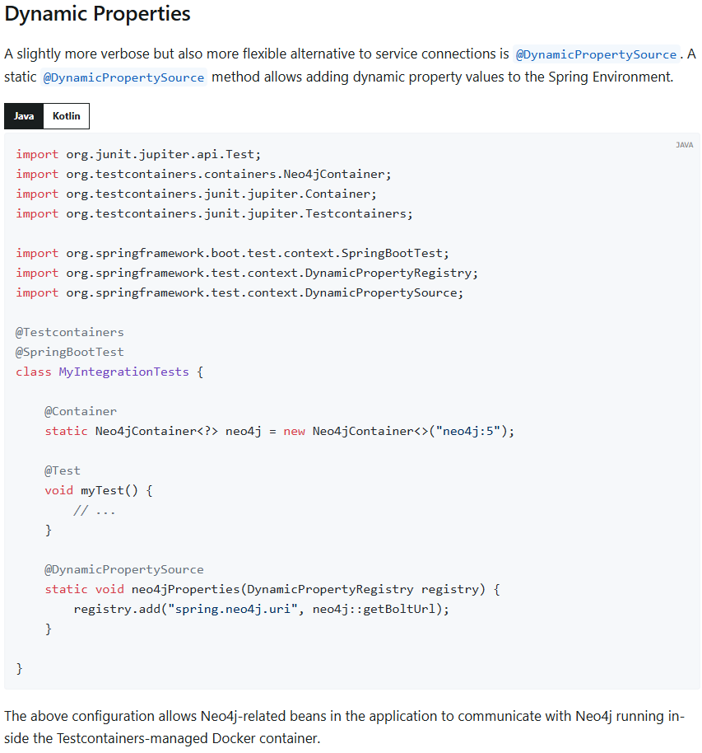

Example 2
TC + SpringBoot
  Dynamic properties (or Service Connections) are used to get real-time configuration elements from containers (e.g.: database connection)

Slide 8
References
https://testcontainers.com/getting-started/
https://docs.spring.io/spring-boot/reference/testing/testcontainers.html

